Slide 1
Geographical Distribution

Slide 2
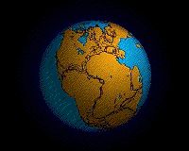
By the end of this lesson, you should be able to:
• | Describe plate tectonics and the movement of continents over time.
• | Describe how the geographical distribution of species provides evidence for evolution.

Slide 3
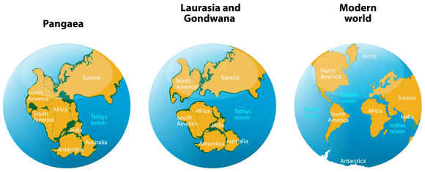
The surface of the earth is made up of many separate plates, which move gradually and continually at a rate of a few centimetres per year.
The continents are located on top of these plates, so as the plates move, so do the continents - this is known as plate tectonics.

Slide 4
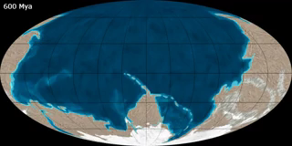
Continental drift is not noticeable in our lifetimes, but over several million years, continents can travel much further apart!
The movement of continents, and the species that live on them, can tell us a lot about evolution.

Slide 5
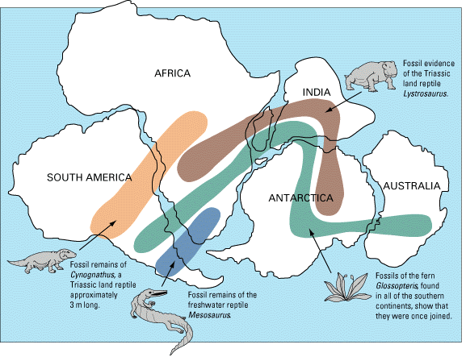
Fossils of the same species have been found on different continents.
This is evidence that tectonic plate movement has occurred - the organisms would not be able to travel the current distance between continents by themselves!

Slide 6
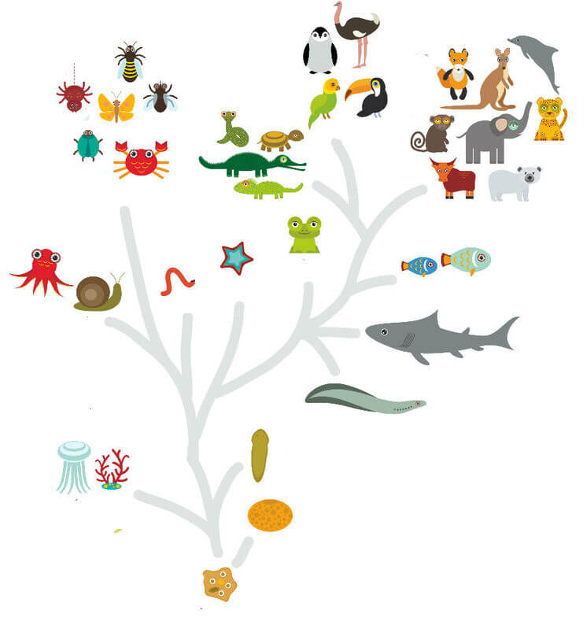
The distribution of closely-related species on continents that were once joined shows that new species can evolve and change when exposed to different environments due to plate tectonics.
This agrees with Darwin's theory of evolution, which says that new species evolve from a common ancestor, and, therefore, that the number of total species increases over time.

Slide 7
The geographical distribution of species provides evidence for evolution by demonstrating what happens when populations of a species are separated geographically, for instance when a continent divides.
The new environment causes the isolated population to adapt and, without interbreeding with the original population, the isolated population can change and become a new species.

Slide 8
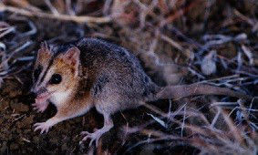
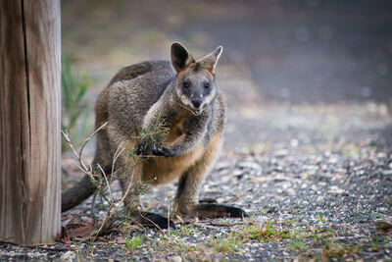
Marsupials are often considered to live only in Australia, but did you know that a few species exist in South America?
South America and Australia were once part of the same landmass. When they split, ancestral marsupial populations were separated and subjected to different climates and conditions. This caused them to adapt to the new conditions, in order to survive.

Slide 9
The group in South America found themselves in competition with placental mammals.
This competition limited the diversification of South American marsupials.
On the other hand, the Australian group were free from competition, and were able to diversify into multiple niches. This is why there are so many different species of Australian marsupial, and only one species of American marsupial!
Even though they have come from the same ancestor, South American marsupials are now so different from Australian marsupials that if they were to ever meet, they would not be able to interbreed.

